Slide 1
ENGS 37 Introduction to Environmental Engineering
Professor Petra Bonfert-Taylor
Contributors: Andy J. Bean, Monika Roznere, and Scott D. Pauls

Slide 2
Audience
Course module is being deployed:
ENGS 37 - Spring 2022 (for Berlin FSP)
~3 weeks on air quality
18 - 20 students (10 or less groups)
Student Cohort:
Basic plotting knowledge (e.g., histogram/scatter plot)
New plots (wind rose, pollution rose, and more) will be explained in the assignments
R and RStudio will be used, but no past experience required
Potential future users:
R introduction assignments can be extended to any group
Openair assignments for any group interested in air quality analysis
Consider tweaking to use US data instead of DE data → data download instructions

Slide 3
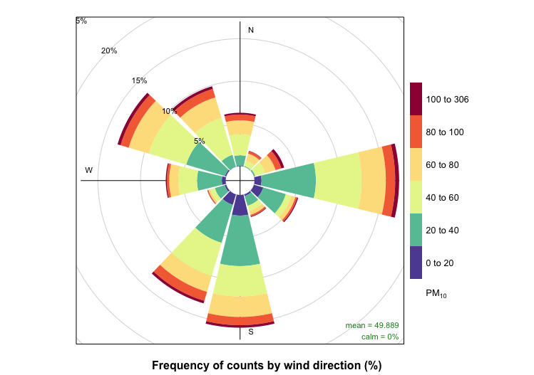
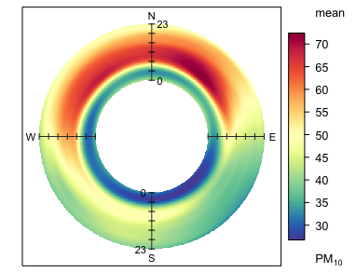
Project Summary
Primary objective: to learn and then apply air quality dispersion modeling using an R-based programming module, with the help of the package ‘openair’ and open-sourced air quality datasets of cities in Germany.
Goals:
Students will be able to:
understand the basics of dispersion modeling
obtain and clean data sets
analyze those data sets
communicate results to peers and target audience members.

Slide 4
Module deployment instructions
Course component: Describe how professors and students will interact with the data science module

Slide 5
Module deployment instructions
Week 1
Mon: Introduction to R and RStudio (Asgmt 1)
Wed: Group Building and Selecting your Germany Site (Asgmt 2 and 6)
Thu: Introduction to R Package Openair (Asgmt 3)
Fri (X-hour): free
Week 2
Mon: Tutorial on Advanced Openair (Asgmt 4 and 5)
Tue & Wed: Group Work
Fri (X-hour): Preliminary Presentations
Week 3
Mon & Wed: Group Work
Thur: Final Presentation 1
Fri (X-hour): Final Presentation 2
Final Week (at end of term)
Media Final Presentations

Slide 6
Module deployment instructions
Tech component: How will students and professors access the modules? Talk about the tech used, where source code is stored, what services are needed for deployment? Where is data stored? Does this code or data need to be updated over time?

Slide 7
Module deployment instructions
Assignment 1: R Installation and Tutorial
Tech: downloading and installing R and RStudio, done before class
Material: slides, full assignment doc / answer doc, answer key
Code: R_intro.R, R_intro_dataset.csv
Assignment 2: Selecting Your Site
Material: slides, full assignment doc, selecting your site sign-up sheet
Code: data files for each Germany site
Assignment 3: Openair Primer
Material: slides, full assignment doc / answer doc, answer key
Code: openair_primer.R, openair_primer_dataset.csv

Slide 8
Module deployment instructions
Assignment 4: Preliminary Presentation
Material: full assignment doc, slides for all-class submission (used for presentation)
Assignment 5: More on Openair
Material: slides, full assignment doc
Code: more_on_openair.R
Assignment 6: Final Project
Material: slides, full assignment doc
*All files will be stored in a class google drive folder, and links to those documents and folders will be included on Canvas

Slide 9
Datasets
Load data in R
Easy to load UK data: openair
Data from rest of Europe, requires cleaning (example code provided): saqgetr
In-class example city dataset:
UK's Automatic Urban and Rural Network (AURN)
More stable; has weather (wind speed and wind direction) already included
site = "my1", year = 2000:2005
Group work datasets:
21 datasets corresponding to different monitoring sites across Germany
Berlin (5), Hannover (2), Leipzig (2), Munich (2), Hamburg (2), Cologne (2), Düsseldorf (2), and Rural Germany near Berlin (3)
Types: suburban, urban, traffic, industrial, rural, near airport
These dataset are cleaned up ahead of time and must be downloaded
Code for extracting air quality data, merging with weather data, and cleaning: AQMET_data_extractor_all.R (in github)

Slide 10
Assignment 1: R Installation and Tutorial
Before class:
R and RStudio installation
Slides (Slides for Asgmt 1) walking through assignment presented during class
Worksheet (Asgmt 1: R Installation and Tutorial) done independently (in class and potentially completed outside of class)
Downloadable dataset in case of R issues (R_intro_dataset.csv)
Answer sheet (Asgmt 1: Answer Sheet) – cut down version of main worksheet
For instructors and TAs
Answer key (Asgmt 1: Answer Key)
Code (R_intro.R)

Slide 11
Assignment 2: Selecting Your Site
Slides (Slides for Asgmt 2 + 6) walking through assignment and introduction to final project
Worksheet completed in groups (Asgmt 2: Selecting Your Site)
Group sign-up sheet for group member names and Germany site(s)
Readings and questions on EPA and EU (Germany) air quality guidelines
Case study reading and questions
Research on your site
Germany data (site csv data)
No answer key or code, graded on reasonable completion

Slide 12
Assignment 3: Openair Primer
Slides (Slides for Asgmt 3) walking through introductory openair package functions
Worksheet completed individually/groups (Asgmt 3: Openair Primer)
Downloadable dataset in case of R issues (openair_primer_dataset.csv)
Answer sheet (Asgmt 3: Answer Sheet) – cut down version of main worksheet
For instructors and TAs
Answer key (Asgmt 3: Answer Key)
Code (openair_primer.R)

Slide 13
Assignment 4: Preliminary Presentation
Document to explain assignment and expectations (Asgmt 4: Preliminary Presentation) – group work
Groups will post preliminary research, figures, and questions into a shared Google Slides
These slides will be then used for a full class day presentation

Slide 14
Assignment 5: More on Openair
Slides (Slides for Asgmt 5) walking through the worksheet with blown-up figures to help guide through student questions
Worksheet completed individually/groups (Asgmt 5: More on Openair)
Data will be based on their individual Germany site data – so plots will look unique
No cut-down answer sheet – they can make one through the full worksheet document
For instructors and TAs
Answer key – none provided as different datasets will be used; use full worksheet document for reference
Code (more_on_openair.R) – steps through the full worksheet document

Slide 15
Assignment 6: Final Project
Slides (Slides for Asgmt 2+6) introduces the final project (done earlier in the first week)
Document to explain assignment and expectations (Asgmt 6: Final Project) – Group Work
Contains instructions and rubric
2 Presentation days for students to showcase their work to their peers
“Gala” type event at end of term to showcase targeted media components

Slide 16
Reflection
How did you end up with this module (from initial concept to eventual deployed module, what changes did you make along the way and why)?
Inspired by Olin College Assignment
Focus on long research paper and policy recommendation were removed due to length
Find datasets first (air quality + weather) → assignment design
openair package → UK only; no Germany data → independent data sites → saqgetr package
Main coding assignments: R tutorial, openair tutorial, and advanced openair tutorial
Presentation assignments:
Preliminary presentation
Final presentation
Targeted media component (Gala)

Slide 17
Reflection
Any helpful resources you found (online resource or person)?
openair:
User friendly documentation: https://bookdown.org/david_carslaw/openair/
Github repo: https://github.com/davidcarslaw/openair
saqgetr (to access data for all of Europe):
Requires library: dplyr as well
Documentation: https://github.com/skgrange/saqgetr
Several other textbooks and articles using air quality data:
Can be found in the resource sections of various assignments

Slide 18
Reflection
What worked well? What didn’t? What did you learn/ takeaway from this whole process?
Looking for suitable data sets for German air quality
Requirements (multiple cities across country, weather data, recent data, ‘uniform’ data)
Took a few weeks
Bad/missing/uniform data
Cleaning data
Good clean data = more concrete assignment structures
Focus on the foundation of the project/module and the rest follows
Focus on data set formation and cleaning
Designing for students to learn something that you find intuitive can be difficult
Make questions granular and specific to engage students

Slide 19
README
Please be sure to update the readme docs of your source code so that any future developer can look at the code and know what needs to be updated and how your code functions.

